Slide 1
BITS Pilani presentation
Amit Dua
Department of Computer Science and Information Systems

Slide 2
CS F212
Lecture No. 7

Slide 3
Lecture outline
Relation Algebra

Slide 4
RA
Procedural language
Six basic operators
  select: σ
  project: ∏
  union: ∪
  set difference: –
  Cartesian product: x
  rename: ρ
The operators take one or two relations as inputs and produce a new relation as a result.

Slide 5
RA
Basic operations:
  Selection : Selects a subset of rows from relation.
  Projection : Deletes unwanted columns from relation.
  Cross-product: Allows us to combine two relations.
  Set-difference : Tuples in reln. 1, but not in reln. 2.
  Union : Tuples in reln. 1 and in reln. 2.
  renaming : Not essential, but (very!) useful.
Additional operations:
  Intersection, join, division,

Slide 6
Select & Project

Slide 7
Banking Example
branch (branch_name, branch_city, assets)
customer (customer_name, customer_street, customer_city)
account (account_number, branch_name, balance)
loan (loan_number, branch_name, amount)
depositor (customer_name, account_number)
borrower (customer_name, loan_number)

Slide 8

The account Relation

Slide 9

The customer Relation

Slide 10

The depositor Relation

Slide 11
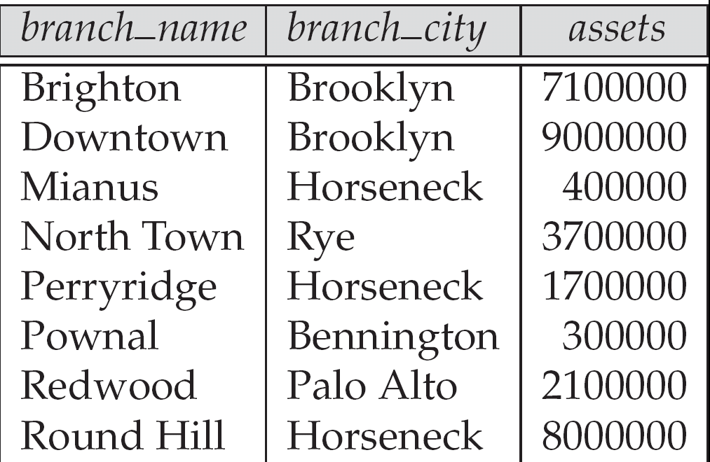
The branch relation

Slide 12

The loan relation

Slide 13
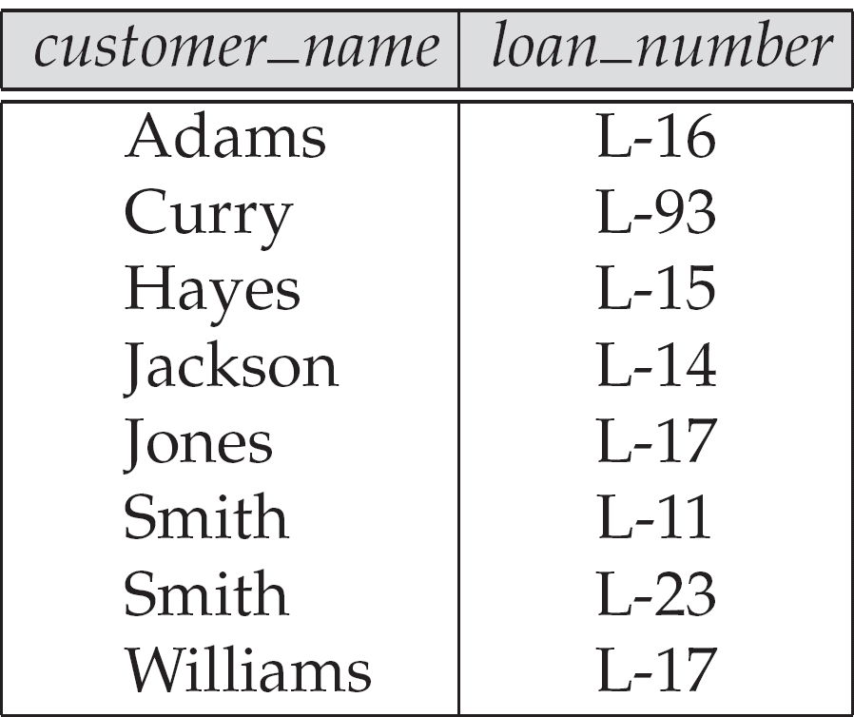
The borrower relation

Slide 14
Select Operation – Example
A
B
C
D
Relation r
α
α
β
β
α
β
β
β
1
5
12
23
7
7
3
10
σ_{A=B ^ D > 5} (r)
A
B
C
D
α
β
α
β
1
23
7
10

Slide 15
Select Operation
Select operation returns a relation that satisfies the given predicate from the original relation.
Notation: σ _{p}(r)
p is called the selection predicate
Defined as:
σ_{p}(r) = {t | t ∈ r and p(t)}
Where p is a formula in propositional calculus consisting of terms connected by : ∧ (and), ∨ (or), ¬ (not)

Slide 16
Each term is one of:
<attribute> op <attribute> or <constant>
where op is one of: =, ≠, >, ≥. <. ≤
Example of selection:
σ _{branch_name=“Perryridge”} (loan), σ _{amount} _{> 1200} (loan)
σ branch_name=“Perryridge” ^ amount _{> 1200} (loan)
σ _{customer_name = banker_name} (loan_officer)

Slide 17
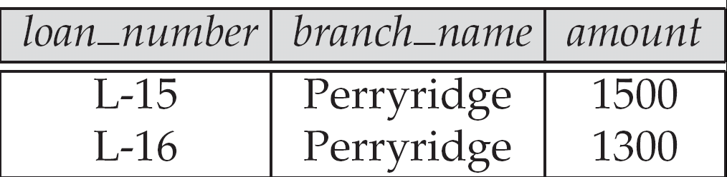
Example
Result of σ_{branch_name = “Perryridge”} (loan)
Loan

Slide 18
Project Operation – Example
Relation r:
A
B
C
α
α
β
β
10
20
30
40
1
1
1
2
∏_{A,C} (r)
A
C
A
C
α
α
β
β
1
1
1
2
α
β
β
1
1
2
=

Slide 19
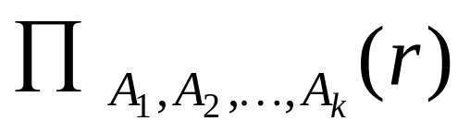
Project Operation
Returns a relation with only the specified attributes.
Notation:
where A₁, A₂ are attribute names and r is a relation name.
The result is defined as the relation of k columns obtained by erasing the columns that are not listed
Duplicate rows removed from result, since relations are sets
Example: To eliminate the branch_name attribute of loan
∏_{loan_number, amount} (loan)

Slide 20
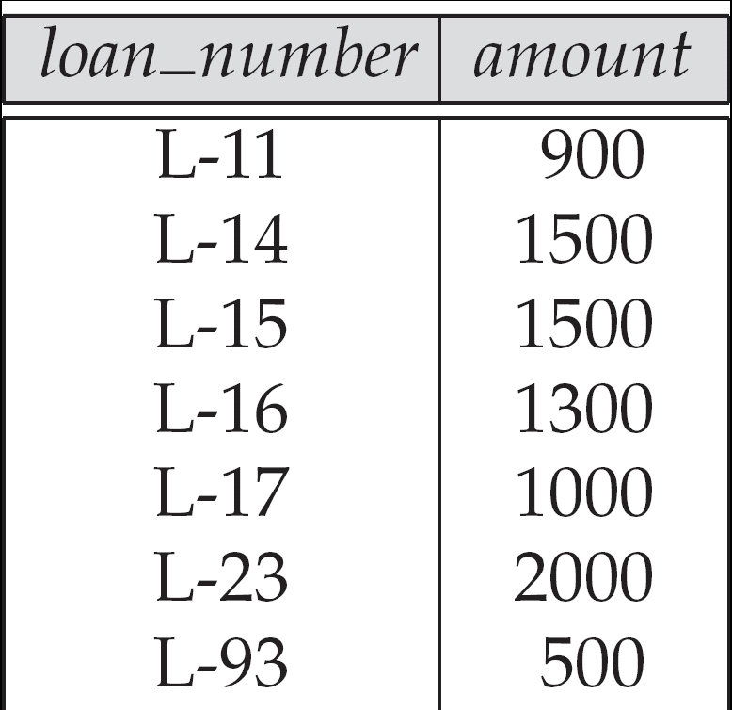
Loan number and the amount of the loan
Loan

Slide 21
Composition of Operations
Composition of Operations
Find the loan number for each loan of an amount greater than $1200
∏_{loan_number} (σ_{amount} _{> 1200} (loan))
loan (loan_number, branch_name, amount)

Slide 22
Union Operation – Example
A
B
A
B
Relations r, s:
r ∪ s:
α
α
β
1
2
1
α
β
2
3
s
r
A
B
α
α
β
β
1
2
1
3

Slide 23
Union Operation
Results in a relation with all of the tuples that appear in either or both of the argument relations.
Notation: r ∪ s
Defined as:
r ∪ s = {t | t ∈ r or t ∈ s}
For r ∪ s to be valid:
1. r, s must have the same arity (same number of attributes)
2. The attribute domains must be compatible (example: 2nd column of r deals with the same type of values as does the 2nd column of s)

Slide 24
Example union
Example: to find all customers with either an account or a loan or both
∏_{customer_name} (depositor) ∪ ∏_{customer_name} (borrower)
depositor (customer_name, account_number)
borrower (customer_name, loan_number)

Slide 25
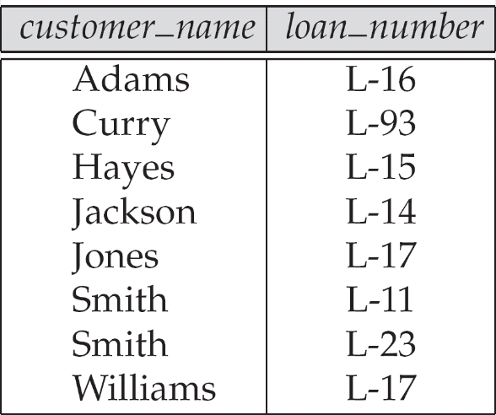
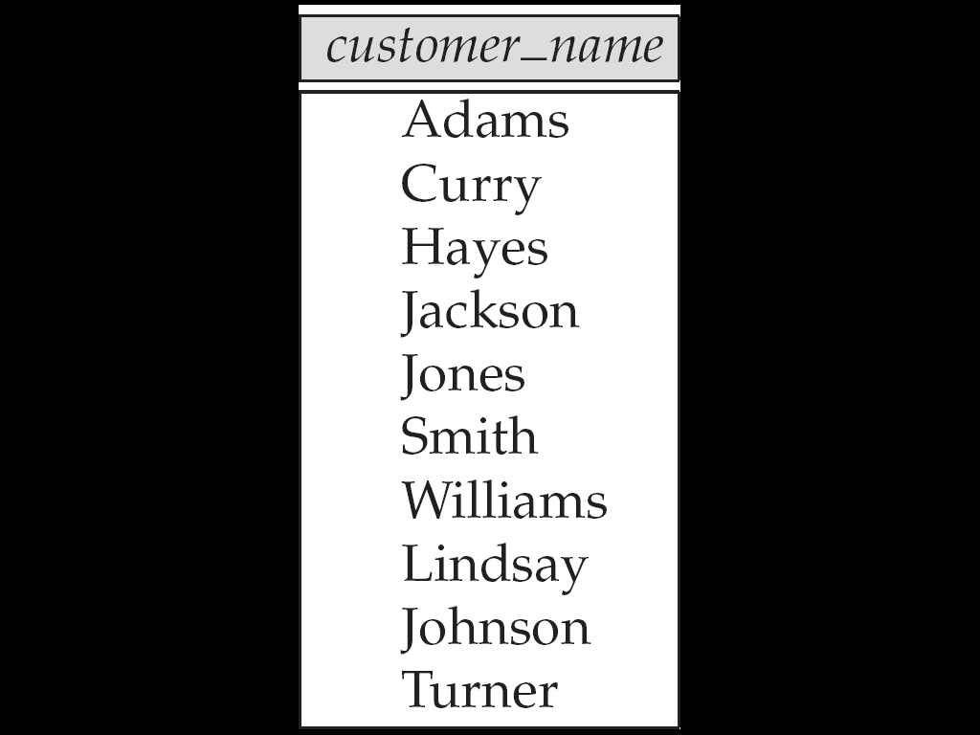
Names of all customers who have either an account or an loan
Borrower
Depositor

Slide 26
Set Difference Operation – Example
A
B
A
B
Relations r, s:
r – s:
α
α
β
1
2
1
α
β
2
3
s
r
A
B
α
β
1
1

Slide 27
Set Difference Operation
R – S produces all tuples in R but not in S
Notation r – s
Defined as:
r – s = {t | t ∈ r and t ∉ s}
Set differences must be taken between compatible relations.
  r and s must have the same arity
  attribute domains of r and s must be compatible

Slide 28
Example
Find the names of all customers with an account but no loan.
∏_{customer_name} (depositor) – ∏_{customer_name} (borrower)
depositor (customer_name, account_number)
borrower (customer_name, loan_number)

Slide 29
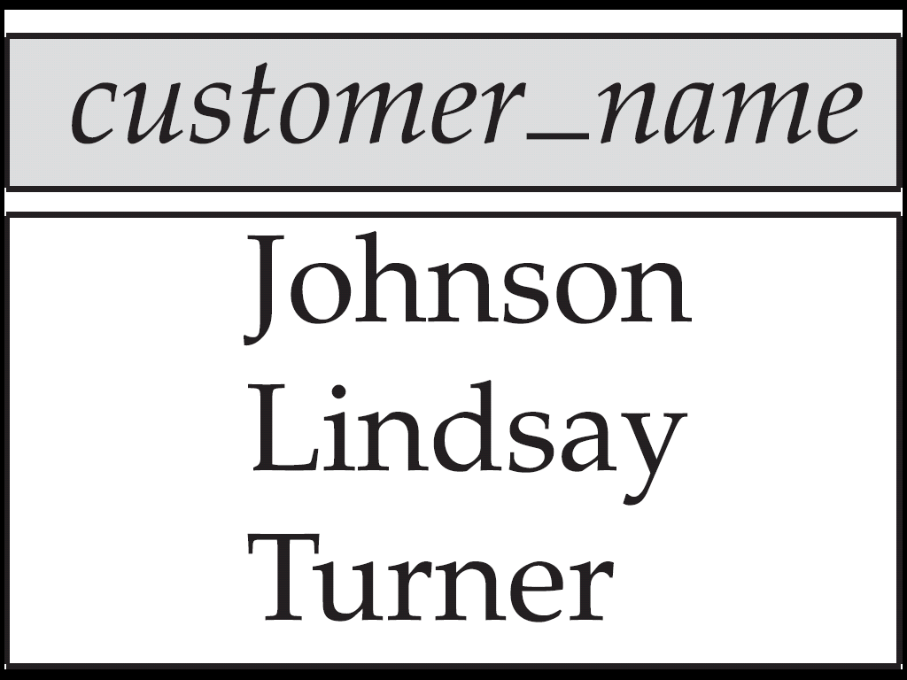
Customers with an account but no loan
Borrower
Depositor

Slide 30
Cartesian-Product Operation – Example
A
B
C
D
E
Relations r, s:
r x s:
α
β
1
2
α
β
β
γ
10
10
20
10
a
a
b
b
r
s
A
B
C
D
E
α
α
α
α
β
β
β
β
1
1
1
1
2
2
2
2
α
β
β
γ
α
β
β
γ
10
10
20
10
10
10
20
10
a
a
b
b
a
a
b
b

Slide 31
Cartesian-Product Operation
Combines any two relations
Output has the attributes of both relations
Notation r x s
Defined as: r x s = {t q | t ∈ r and q ∈ s}
If n1 is the no. of tuples in r and n2 is the no. of tuples in s, then the no. of tuples in the relation r X s will be n1 * n2.
Assume that attributes of r(R) and s(S) are disjoint. (That is, R ∩ S = ∅).
If attributes of r and s are not disjoint, then renaming must be used.

Slide 32
Example
Repeated attribute names are preceded by the relation they originated from.
Example: r= borrower × loan
(borrower.customer-name, borrower.loan-number,
loan.loan-number, loan.branch-name, loan.amount)

Slide 33
Example Queries
Find the names of all customers who have a loan at the Perryridge branch.
∏_{customer_name} (σborrower.loan_number = loan.loan_number
₍σ _{branch_name=“Perryridge”} (borrower x loan)))
Loan
borrower

Slide 34
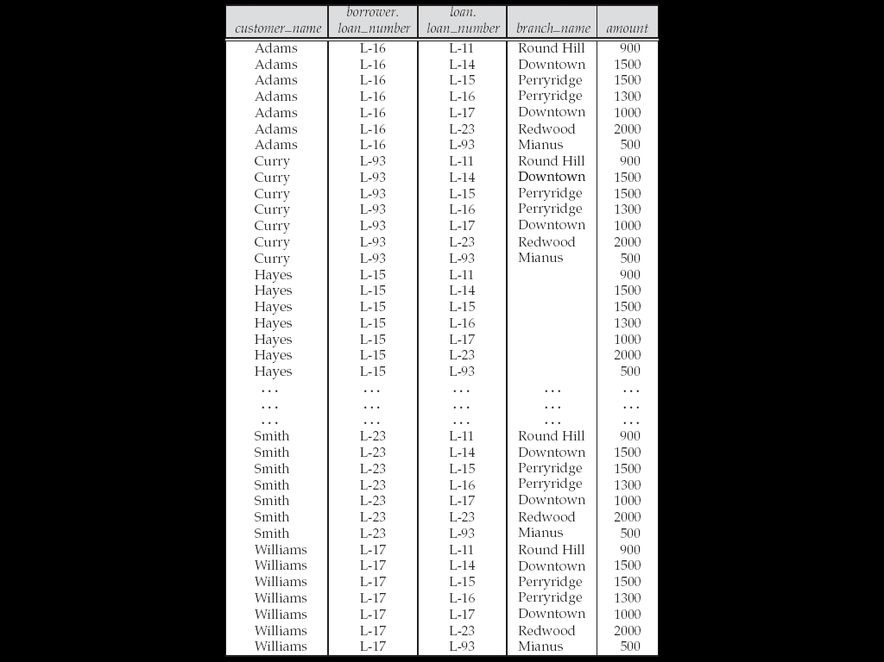
Result of borrower X loan
Borrower
Loan

Slide 35
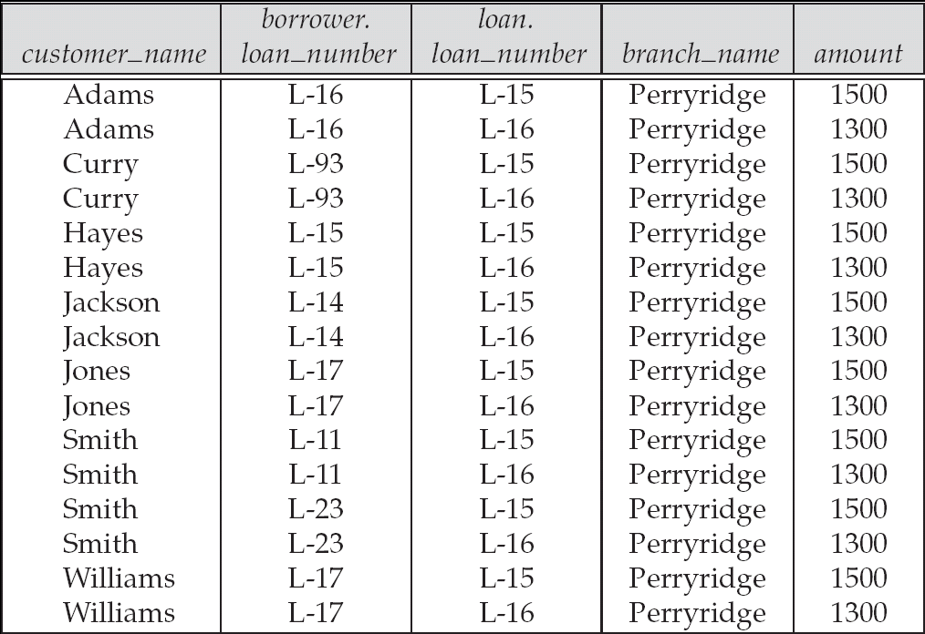
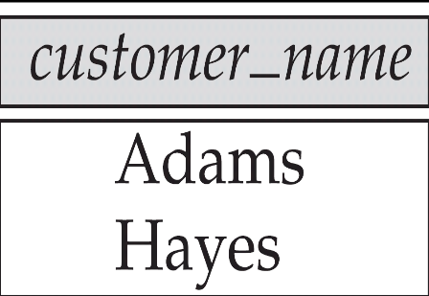

Slide 36
Find the names of all customers who have a loan at the Perryridge branch.
  Query 1
  ∏_{customer_name} (σ borrower.loan_number = loan.loan_number
  (σ _{branch_name = “Perryridge”} (borrower x loan)))
  Query 2
  ∏_{customer_name}(σloan.loan_number = borrower.loan_number (
  (σ_{branch_name = “Perryridge”} (loan)) x borrower))

Slide 37

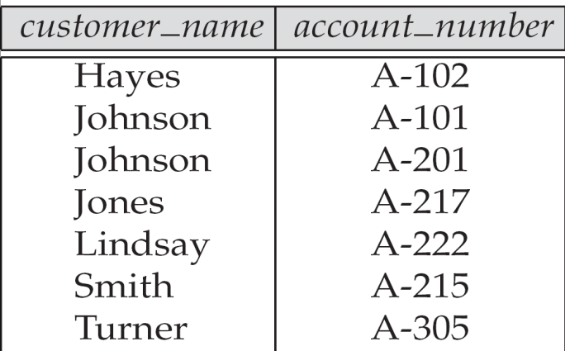
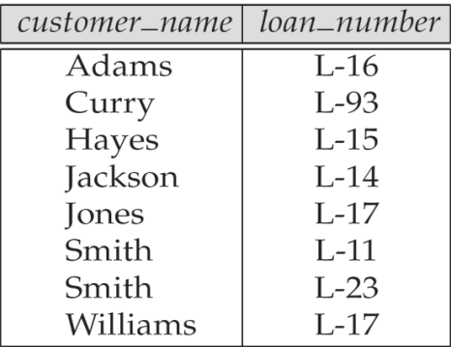
Example Queries
Find the names of all customers who have a loan at the Perryridge branch but do not have an account at any branch of the bank.
∏_{customer_name} (σ_{branch_name = “Perryridge”}
(σborrower.loan_number = loan.loan_number(borrower x loan))) – ∏_{customer_name}(depositor)
Loan
borrower
depositor
customer (customer_name, customer_street, customer_city)

Slide 38

Rename Operation
Allows us to name, and therefore to refer to, the results of relational-algebra expressions.
Allows us to refer to a relation by more than one name.
Example:
ρ _{x} (E)
returns the expression E under the name X
If a relational-algebra expression E has arity n, then
returns the result of expression E under the name X, and with the attributes renamed to A₁ , A₂ , …., A_{n} .
Useful for naming the unnamed relations returned from other operations.

Slide 39
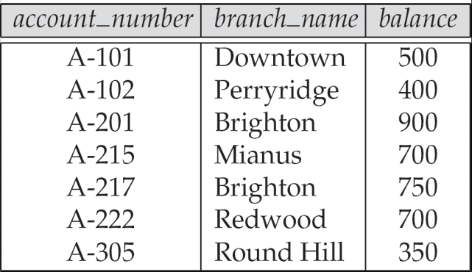
Find the largest account balance
  Strategy:
    Find those balances that are not the largest
      Rename account relation as d so that we can compare each account balance with all others
    Use set difference to find those account balances that were not found in the earlier step.
  The query is:
∏_{balance}(account) - ∏_{account.balance}
(σ_{account.balance < d.balance} (account x ρ_{d} (account)))
Account

Slide 40
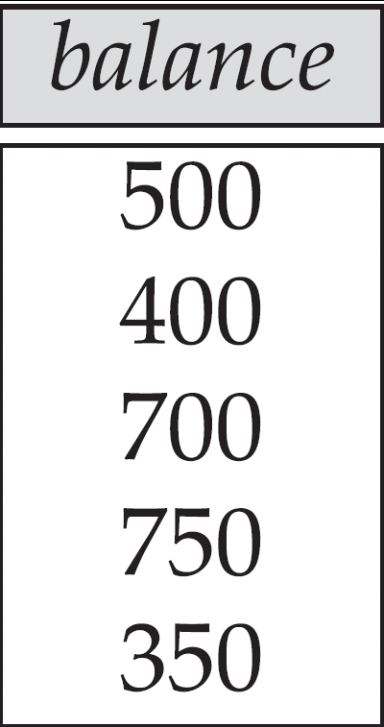
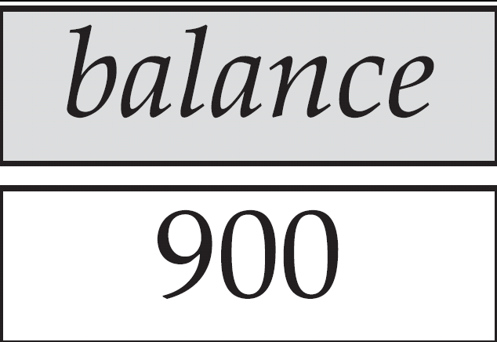
Largest account balance in the bank

Slide 41
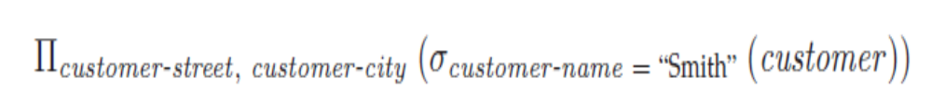
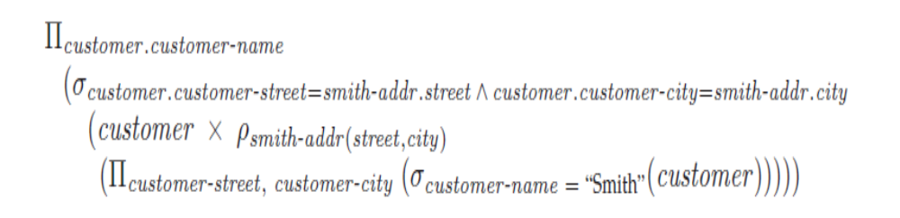
Example Queries
Find the names of all customers who live on the same street and in the same city as Smith.
Strategy:
Smith’s street and city is given by the query:
customer (customer_name, customer_street, customer_city)
  The result query is:

Slide 42
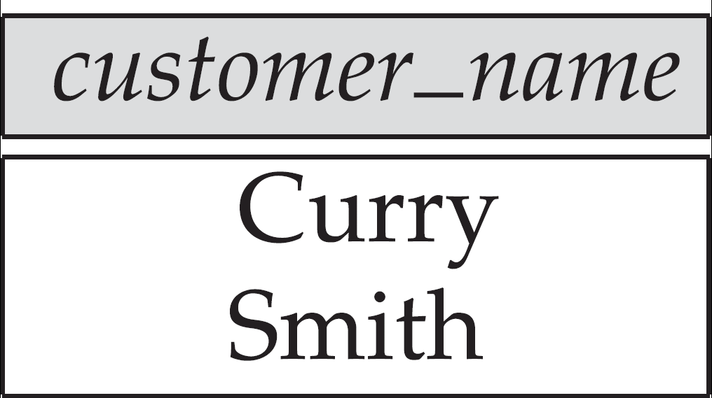
Customers who live on the same street and in the same city as Smith
Customer

Slide 43
Relational algebra
select, project, union, intersection, difference, Cartesian product, rename
Examples

Slide 44
Example
Find the names of all customers who have a loan at the Perryridge branch.
∏_{customer_name} (σborrower.loan_number = loan.loan_number
₍σ _{branch_name=“Perryridge”} (borrower x loan)))
Loan
borrower

Slide 45
Result of borrower X loan

Slide 46
Example Queries
Find the names of all customers who have a loan at the Perryridge branch.
  Query 1
  ∏_{customer_name} (σ borrower.loan_number = loan.loan_number
  (σ _{branch_name = “Perryridge”} (borrower x loan)))

Slide 47
Discussion
What is the need for RA?

Slide 48
Additional Operations
We define additional operations that do not add any power to the
relational algebra, but that simplify common queries.
Set intersection
Natural join
Division

Slide 49
Set-Intersection Operation – Example

Slide 50
Natural-Join Operation
Let r and s be relations on schemas R and S respectively.
Then, r s is a relation on schema R ∪ S obtained as follows:
  Consider each pair of tuples t_{r} from r and t_{s} from s.
  If t_{r} and t_{s} have the same value on each of the attributes in R ∩ S, add a tuple t to the result, where
    t has the same value as t_{r} on r
    t has the same value as t_{s} on s
Example:
  R = (A, B, C, D)
  S = (E, B, D)
  Result schema = (A, B, C, D, E)
  r s is defined as:
  ∏_{r.A, r.B, r.C, r.D, s.E} (σ_{r.B = s.B} ∧ _{r.D = s.D} (r x s))

Slide 52
Bank Example Queries
Find the names of all customers who have a loan and an account at bank.
Query 1: ∏customer_name (borrower) ∩ ∏customer_name (depositor)
  Query 2: ∏_{customer_name} (borrower depositor)
loan (loan_number, branch_name, amount)
depositor (customer_name, account_number)
borrower (customer_name, loan_number)

Slide 53
Find the names of all customers who have a loan at the Perryridge branch
_{Query 1:}
∏customer_name (σ borrower.loan_number = loan.loan_number (σ branch_name = “Perryridge” (borrower x loan)))
  Query 2: ∏_{customer_name} (σ _{branch_name = “Perryridge”} (borrower loan))

Slide 54
Natural Join is associative.

Slide 55
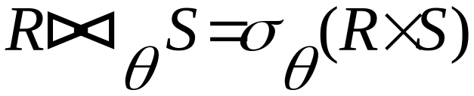
Theta Join
Condition Join:
Result schema same as that of cross-product.
Fewer tuples than cross-product, might be able to compute more efficiently
Sometimes called a theta-join.

Slide 56
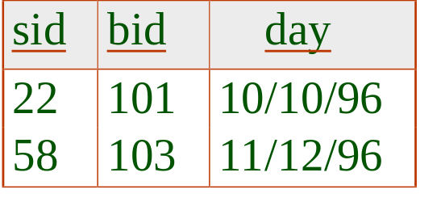
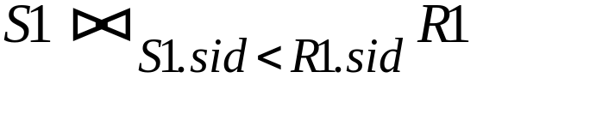
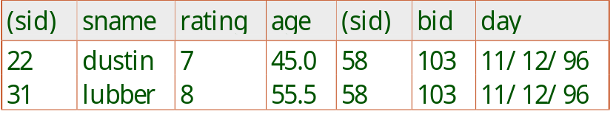
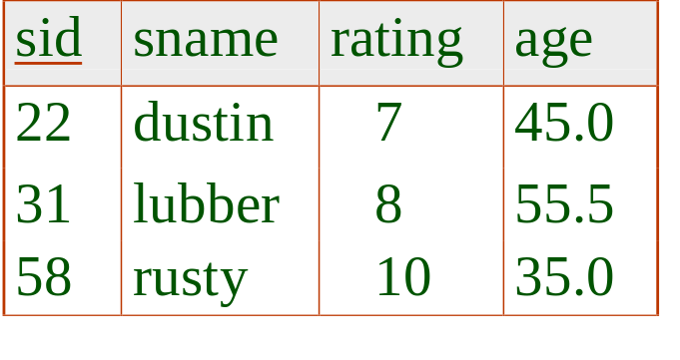
Example Instances
“Sailors” and “Reserves” relations
for our examples.
R1
S1

Slide 57
Division Operation – Example
A
B
B
Relations r, s:
α
α
α
β
γ
δ
δ
δ
∈
∈
β
1
2
3
1
1
1
3
4
6
1
2
1
2
s
r ÷ s:
A
r
α
β

Slide 58
Another Division Example
A
B
C
D
E
D
E
Relations r, s:
α
α
α
β
β
γ
γ
γ
a
a
a
a
a
a
a
a
α
γ
γ
γ
γ
γ
γ
β
a
a
b
a
b
a
b
b
1
1
1
1
3
1
1
1
a
b
1
1
s
r
r ÷ s:
A
B
C
α
γ
a
a
γ
γ

Slide 59
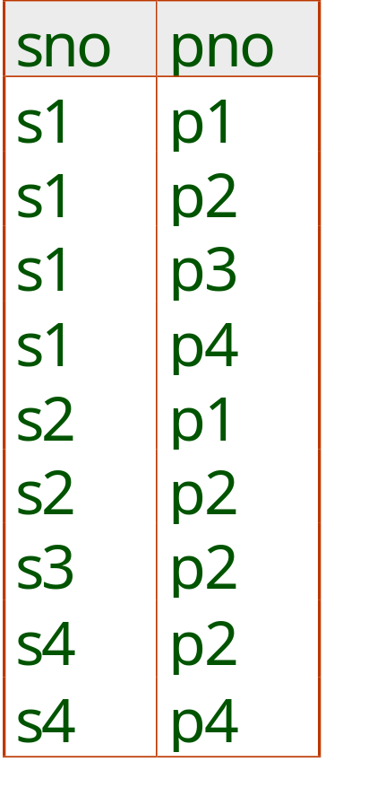
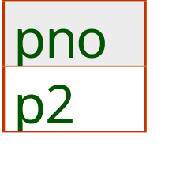
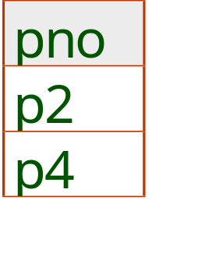
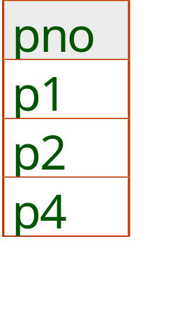
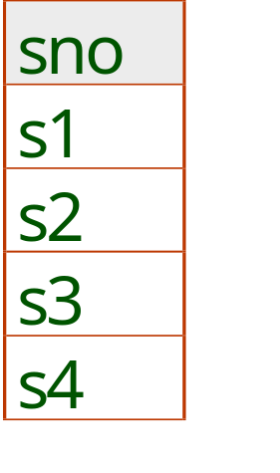
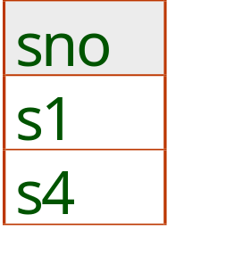
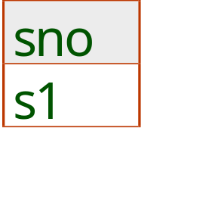
B1
B2
B3
A
A/B1
A/B2
A/B3

Slide 60
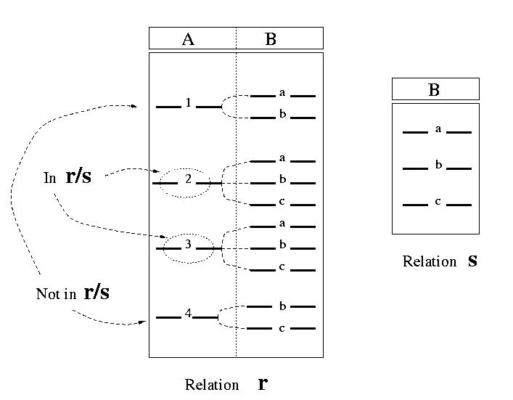

Slide 61
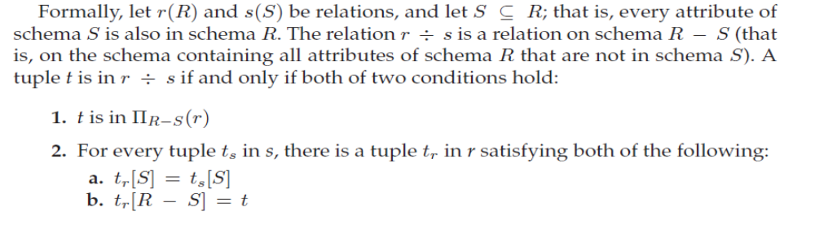
Division Operation

Slide 62
Generalized Projection
Aggregate Functions
Outer Join

Slide 63
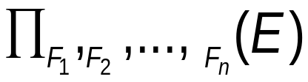
Extends the projection operation by allowing arithmetic functions to be used in the projection list.
E is any relational-algebra expression
Each of F₁, F₂, …, F_{n} are arithmetic expressions involving constants and attributes in the schema of E.
Given relation credit_info(customer_name, limit, credit_balance), find how much more each person can spend:
∏customer_name, limit – credit_balance (credit_info)

Slide 64

Aggregation function takes a collection of values and returns a single value as a result.
avg: average value
min: minimum value
max: maximum value
sum: sum of values
count: number of values
Aggregate operation in relational algebra
E is any relational-algebra expression
  G₁, G₂ …, G_{n} is a list of attributes on which to group (can be empty)
  Each F_{i} is an aggregate function
  Each A_{i} is an attribute name

Slide 65
Aggregate Operation – Example
A
B
C
g _{sum(c)} (r)
α
α
β
β
α
β
β
β
7
7
3
10
sum(c )
27

Slide 66
Aggregate Operation – Example
Relation account grouped by branch-name:
branch_name
account_number
balance
Perryridge
Perryridge
Brighton
Brighton
Redwood
A-102
A-201
A-217
A-215
A-222
400
900
750
750
700
_{branch_name} g _{sum(balance)} (account)
branch_name
sum(balance)
Perryridge
Brighton
Redwood
1300
1500
700

Slide 67
Result of aggregation does not have a name
  Can use rename operation to give it a name
  For convenience, we permit renaming as part of aggregate operation
_{branch_name} g _{sum(balance) as sum_balance} (account)

Slide 68
An extension of the join operation that avoids loss of information.
Computes the join and then adds tuples from one relation that does not match tuples in the other relation to the result of the join.
Uses null values:
  null signifies that the value is unknown or does not exist
  All comparisons involving null are (roughly speaking) false by definition.
    We shall study precise meaning of comparisons with nulls later

Slide 69
Relation loan
Relation borrower
loan_number
branch_name
amount
L-170
L-230
L-260
Downtown
Redwood
Perryridge
3000
4000
1700
customer_name
loan_number
Jones
Smith
Hayes
L-170
L-230
L-155

Slide 70
Join
loan borrower
loan_number
branch_name
amount
customer_name
L-170
L-230
Downtown
Redwood
3000
4000
Jones
Smith
Left Outer Join
loan borrower
loan_number
branch_name
amount
customer_name
L-170
L-230
L-260
Downtown
Redwood
Perryridge
3000
4000
1700
Jones
Smith
null

Slide 71
Right Outer Join
loan borrower
loan_number
branch_name
amount
customer_name
L-170
L-230
L-155
Downtown
Redwood
null
3000
4000
null
Jones
Smith
Hayes
Full Outer Join
loan borrower
loan_number
branch_name
amount
customer_name
L-170
L-230
L-260
L-155
Downtown
Redwood
Perryridge
null
3000
4000
1700
null
Jones
Smith
null
Hayes

Slide 72
Select
Project
Union, intersection, difference
Cartesian product
Natural join
Theta join
Outer joins
Rename
Group by operations

